Slide 1
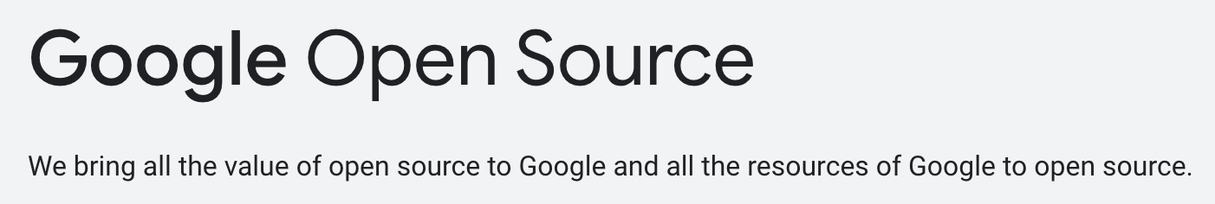
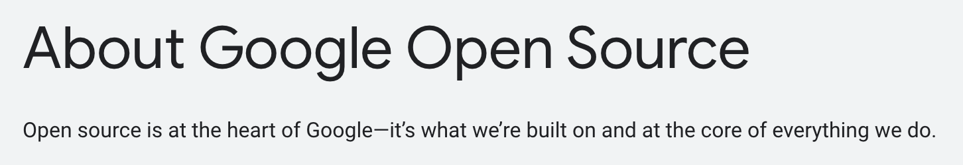
Google: Open Source is not only good Samaritans
https://www.kamilfranek.com/how-google-makes-money-from-android/

Slide 2
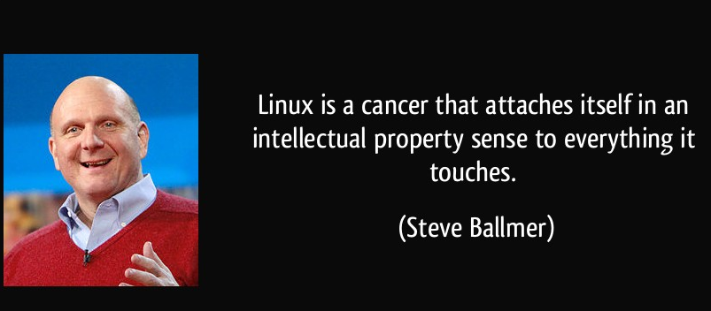
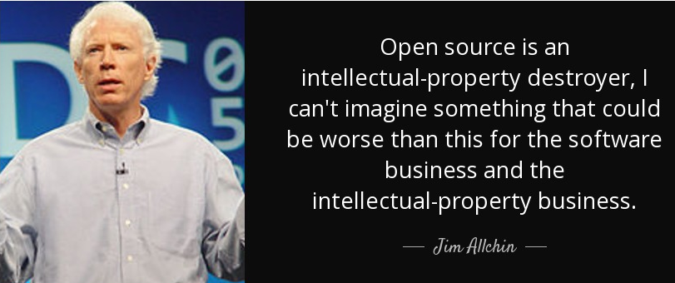
Microsoft: From one extreme to another
Most of you steal your software. --- Bill Gates

Slide 3
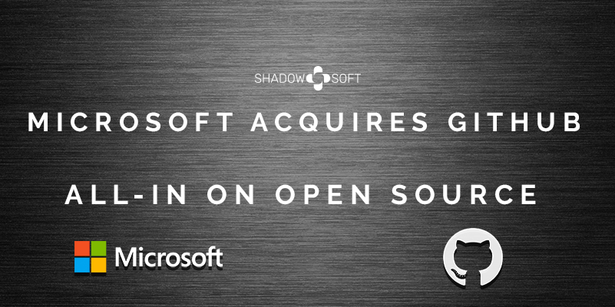
Microsoft: From one extreme to another
Will Windows become the best Linux distribution?
- Released in 2016, Windows Subsystem for Linux (WSL) lets developers run a GNU/Linux environment -- including most command-line tools, utilities, and applications -- directly on Windows, unmodified, without the overhead of a traditional virtual machine or dual-boot setup.
Microsoft acquired GitHubfor $7.5 billion in stock in 2018
- CEO Satya Nadella said, “we strengthen our commitment to developer freedom, openness and innovation.”

Slide 4
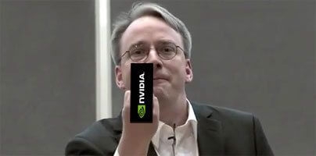
Nvidia: Another example
NVIDIA is notorious in open source community
- NVIDIA has been one of the worst trouble spot we have had with hardware manufacturers. Linus Torvalds
Response on NVIDIA open source
https://blogs.gnome.org/uraeus/2022/05/11/why-is-the-open-source-driver-release-from-nvidia-so-important-for-linux/
https://developer.nvidia.com/blog/nvidia-releases-open-source-gpu-kernel-modules/

Slide 5
PingCap: The best way for talent recruitment

Slide 6
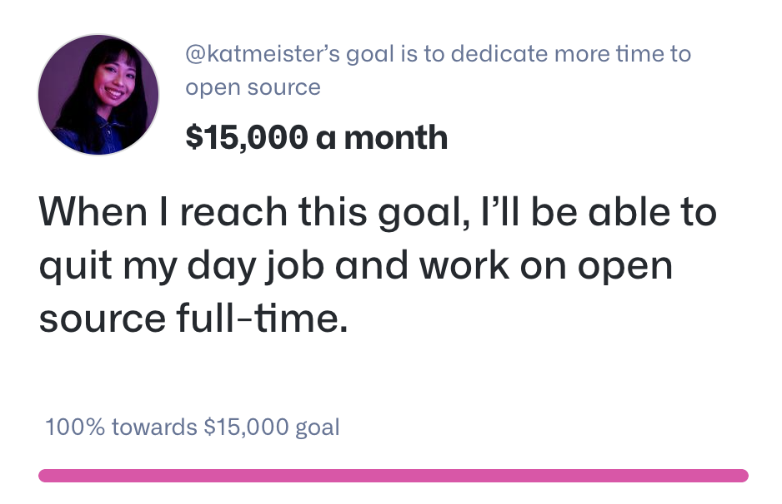

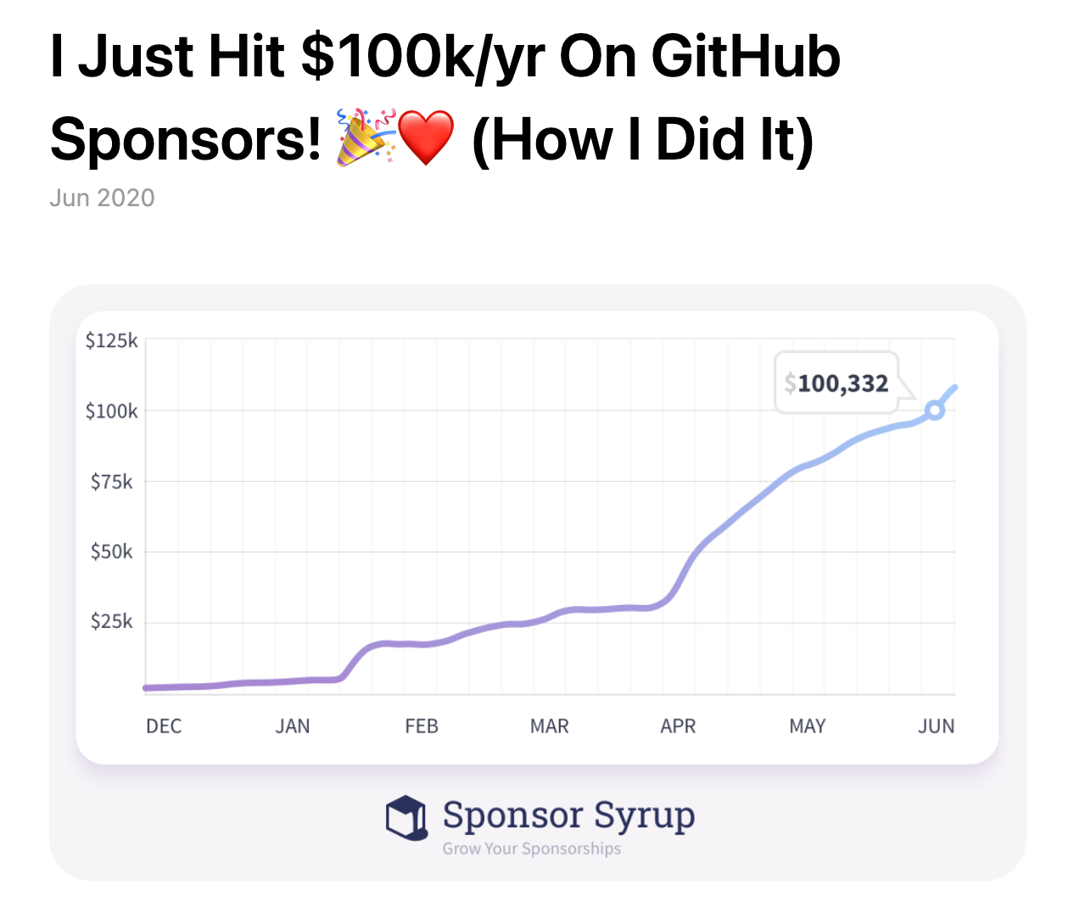
Personal: Financial independence
With Github Sponsors, working for hobby is not a dream!
https://calebporzio.com/i-just-hit-dollar-100000yr-on-github-sponsors-heres-how-i-did-it
https://github.com/sponsors

Slide 7
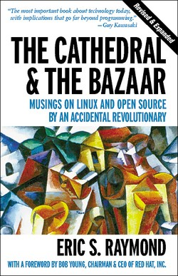
http://www.catb.org/esr/writings/cathedral-bazaar/

Slide 8
Heroes of Open Source Movement

Slide 9

Open Source Initiative
https://opensource.org/osd
The OSI logo, which combines the "O" of open and a keyhole, for unlocking source code, was created by Colin Viebrock.

Slide 10
Books
A book list can be found here: https://opensourceway.community/posts/paper_or_book_reading/2020_book_lists/

Slide 11
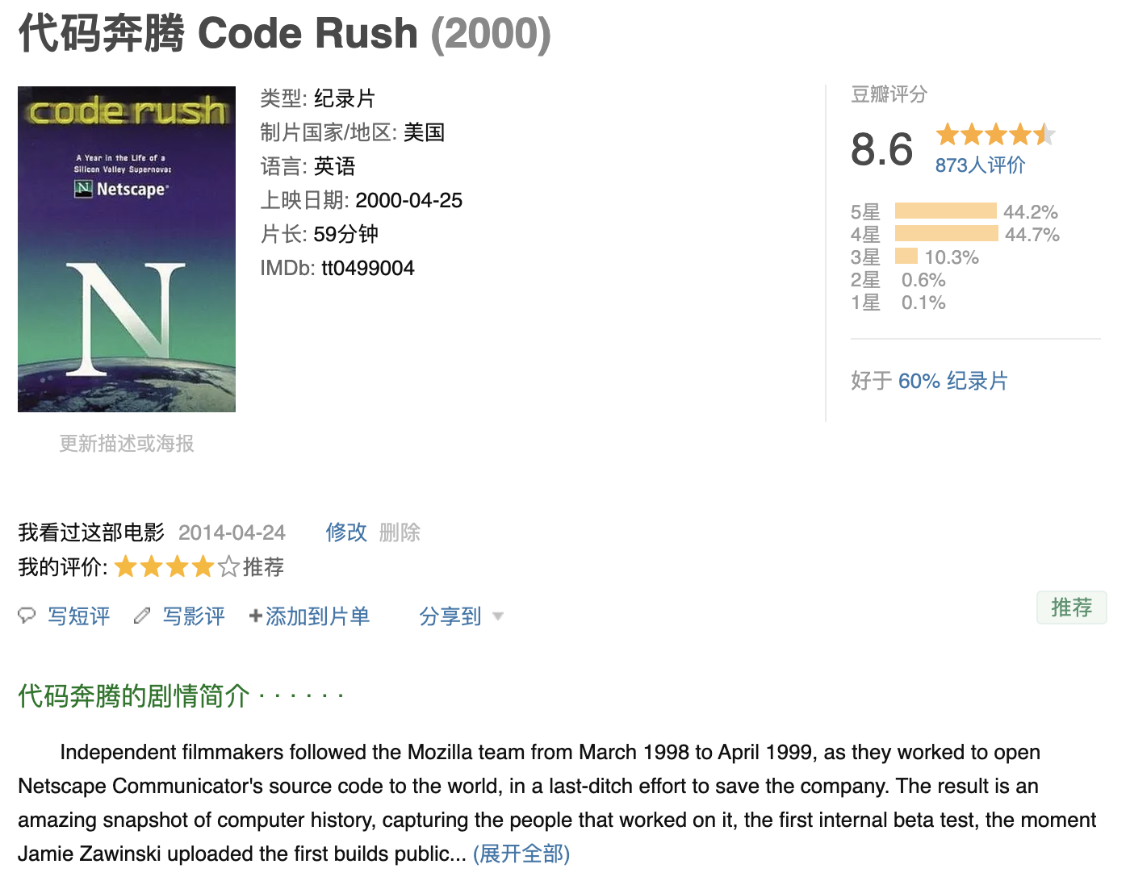
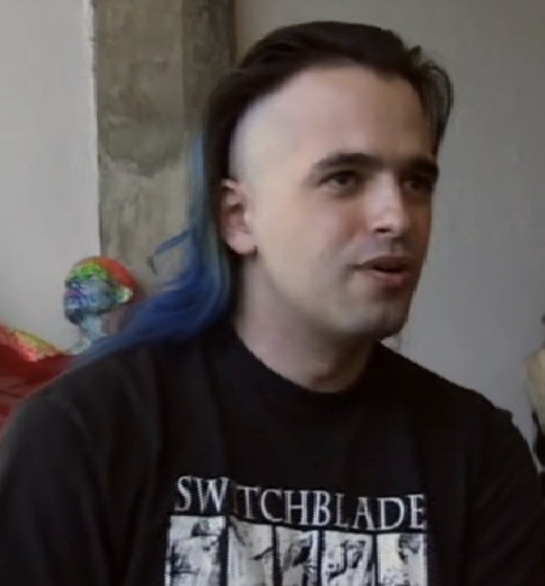
Documentary
More documentaries can be found here:
https://www.bilibili.com/video/BV1wS4y127S5?spm_id_from=333.999.0.0
https://www.bilibili.com/video/BV1644y1V7Yz/?spm_id_from=333.788.recommend_more_video.-1
Notes:
https://www.jwz.org/

Slide 12
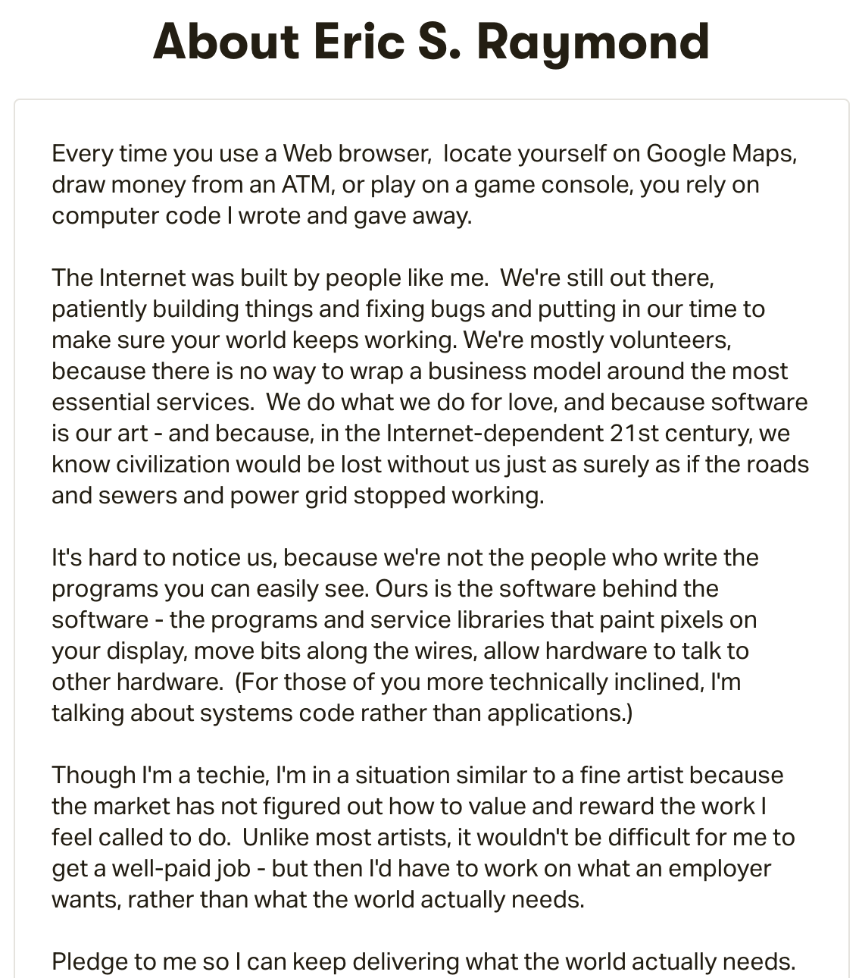
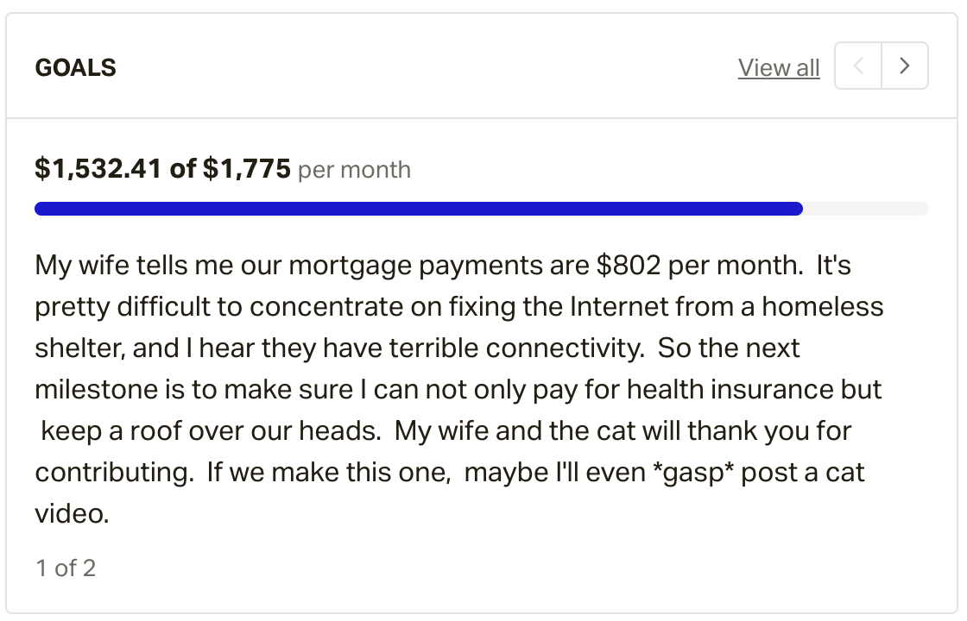
Contradiction between ideals and reality
In 2015, ESR tried to raise money on Patreon for his family
https://www.patreon.com/esr

Slide 13
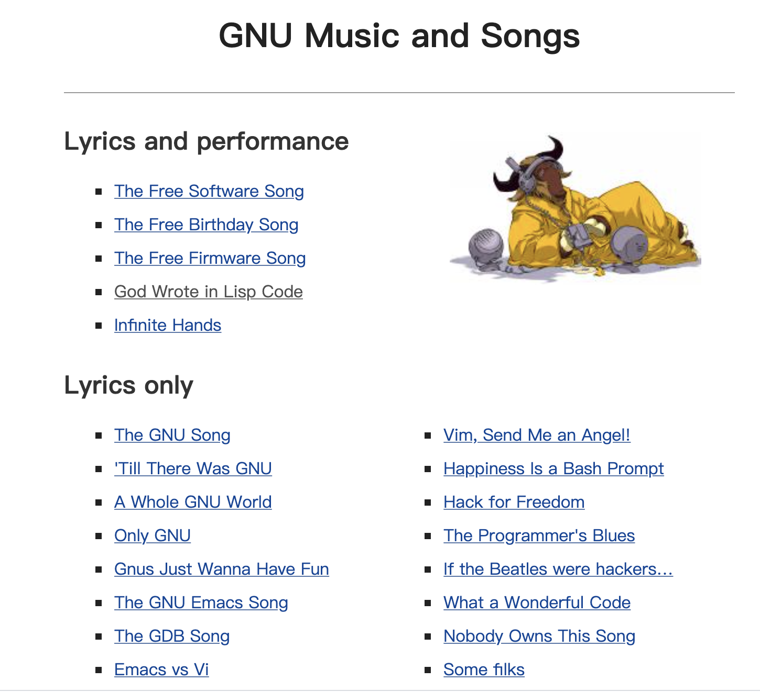
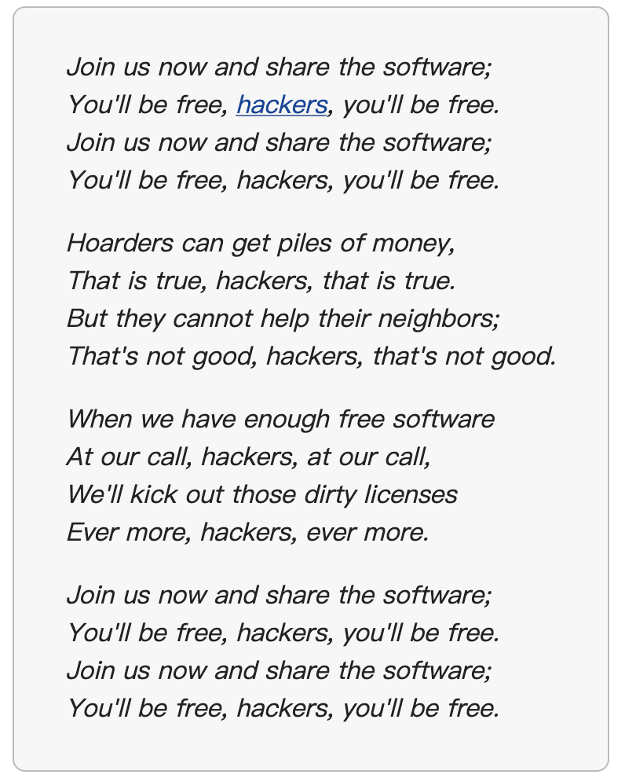
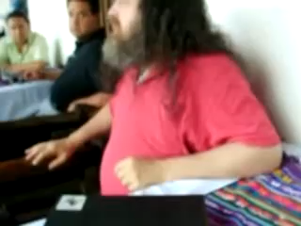
Songs for open source
https://www.gnu.org/music/free-software-song.en.html
https://www.gnu.org/music/music.html#content

Slide 14
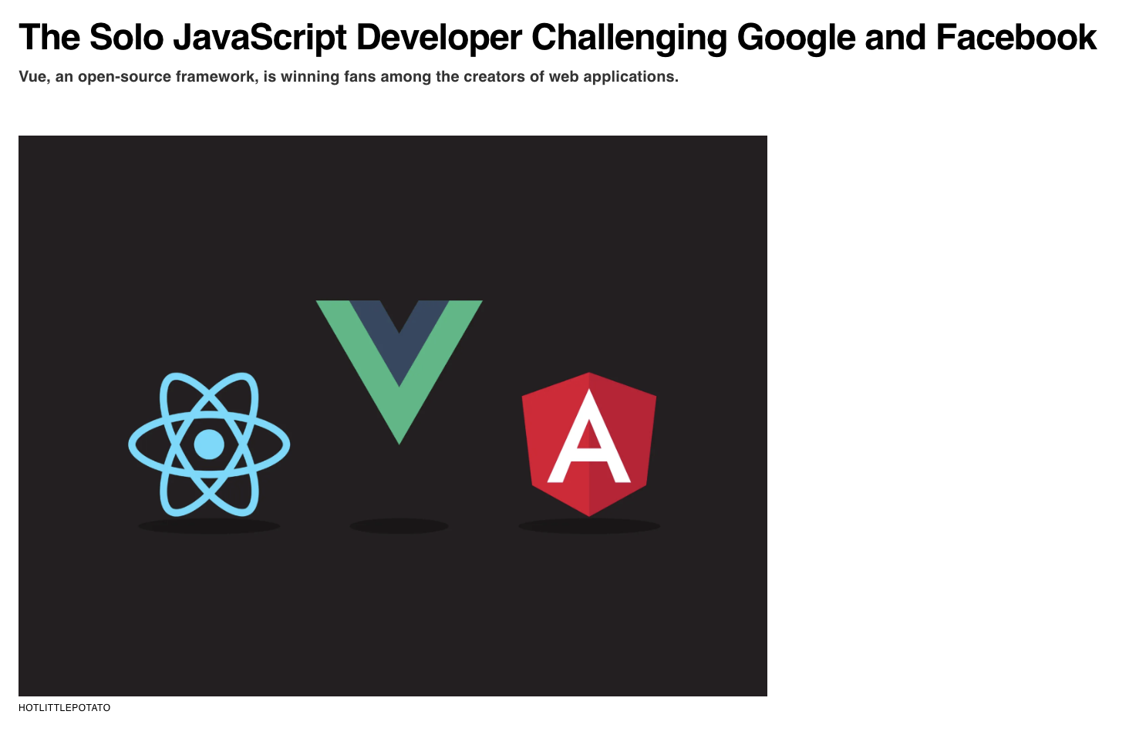
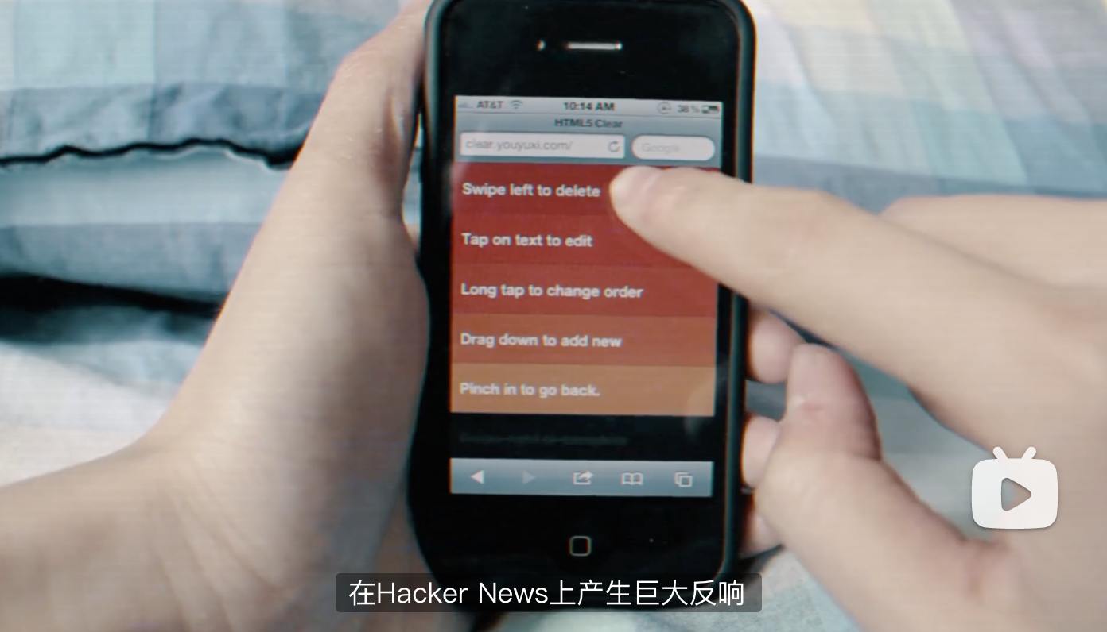
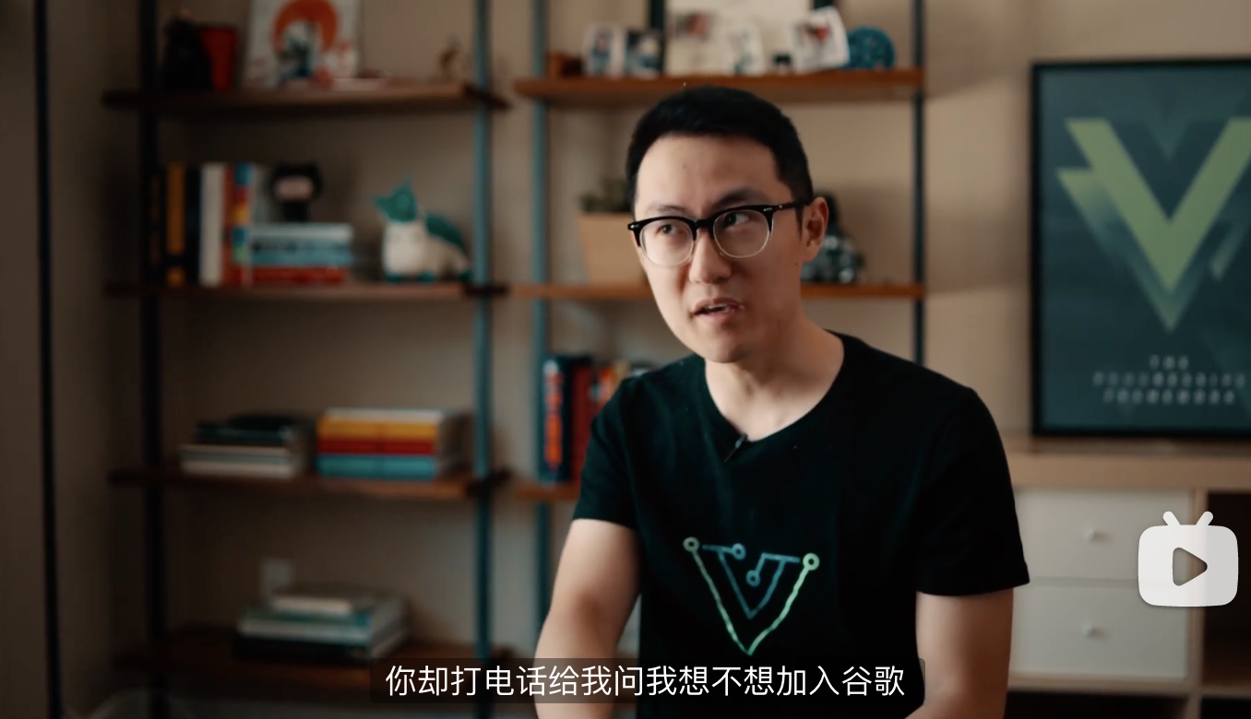
Open Source is not silver bullet
The solo developer of Vue.js is not nobody
The number of stars is less than 10 for most repos (> 95%)
FYI, InsightFace has 11.7K stars and ranks 1890
https://www.wired.com/story/the-solo-javascript-developer-challenging-google-facebook/

Slide 15
https://www.ibm.com/opensource/
https://www.theregister.com/2020/08/04/gpl_condom_nvidia_linux_kernel/

